Slide 1
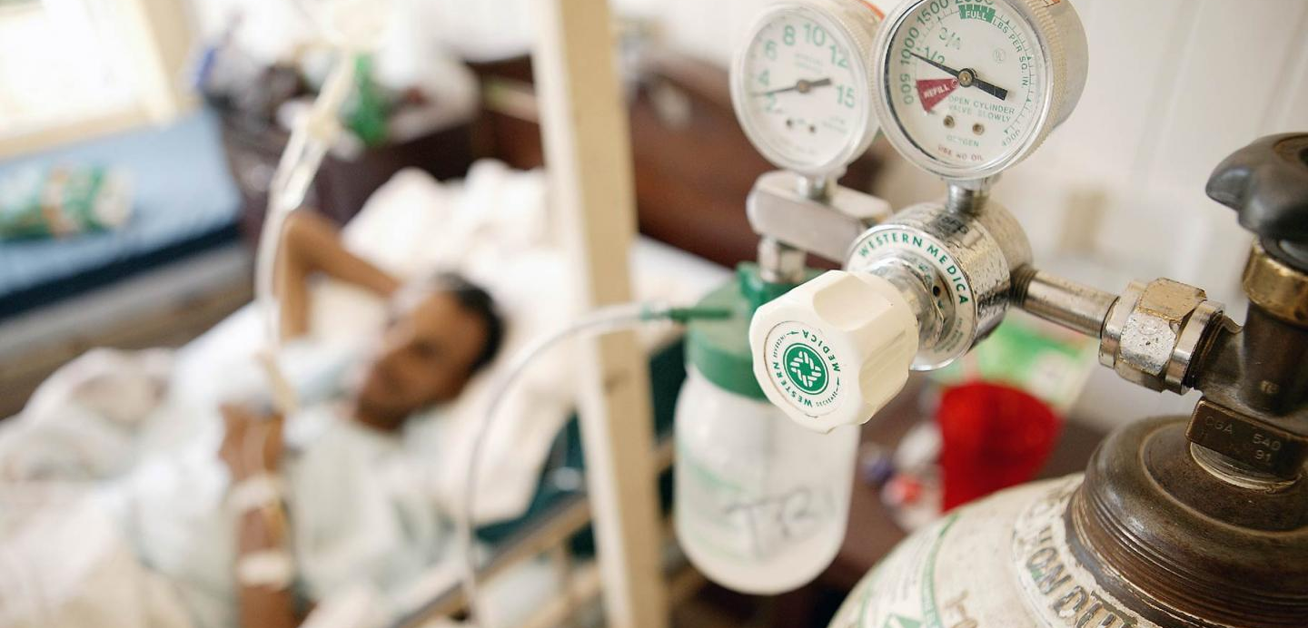

DAMG 6210 Data Management and Database Design
GROUP – 9 PROJECT TOPIC: OXYGEN RENTAL SYSTEM
Group Members:
Namratha Gonuguntla (001565081)
Nithin Dornipadu (002197358)
Rajesh Kaireddy (002198556)
Sai Kumar Ganga (002191288)

Slide 2
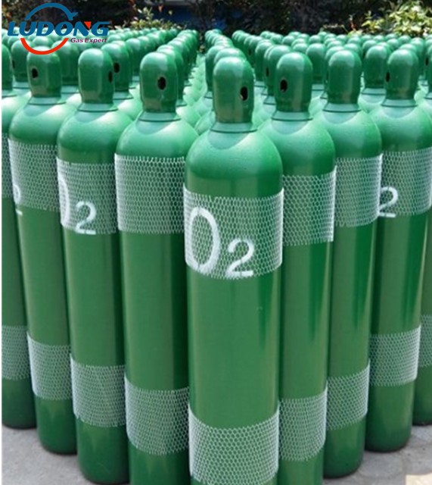
Problem Statement:
To provide a platform where people can connect to the nearest oxygen suppliers for oxygen cylinders in emergency.
Objectives:
Maintain (Insert, Update, delete) data of Oxygen plant locations and Customers.
Maintain the Booking History (Unique transaction ID, Customer ID, plant ID, quantity) to visualize and generate a report on demand of oxygen across county.
Security: Providing them a login-logout option based on Authorization role for security purposes.
Maintain Data Integrity and Avoid Data Redundancy.

Slide 3
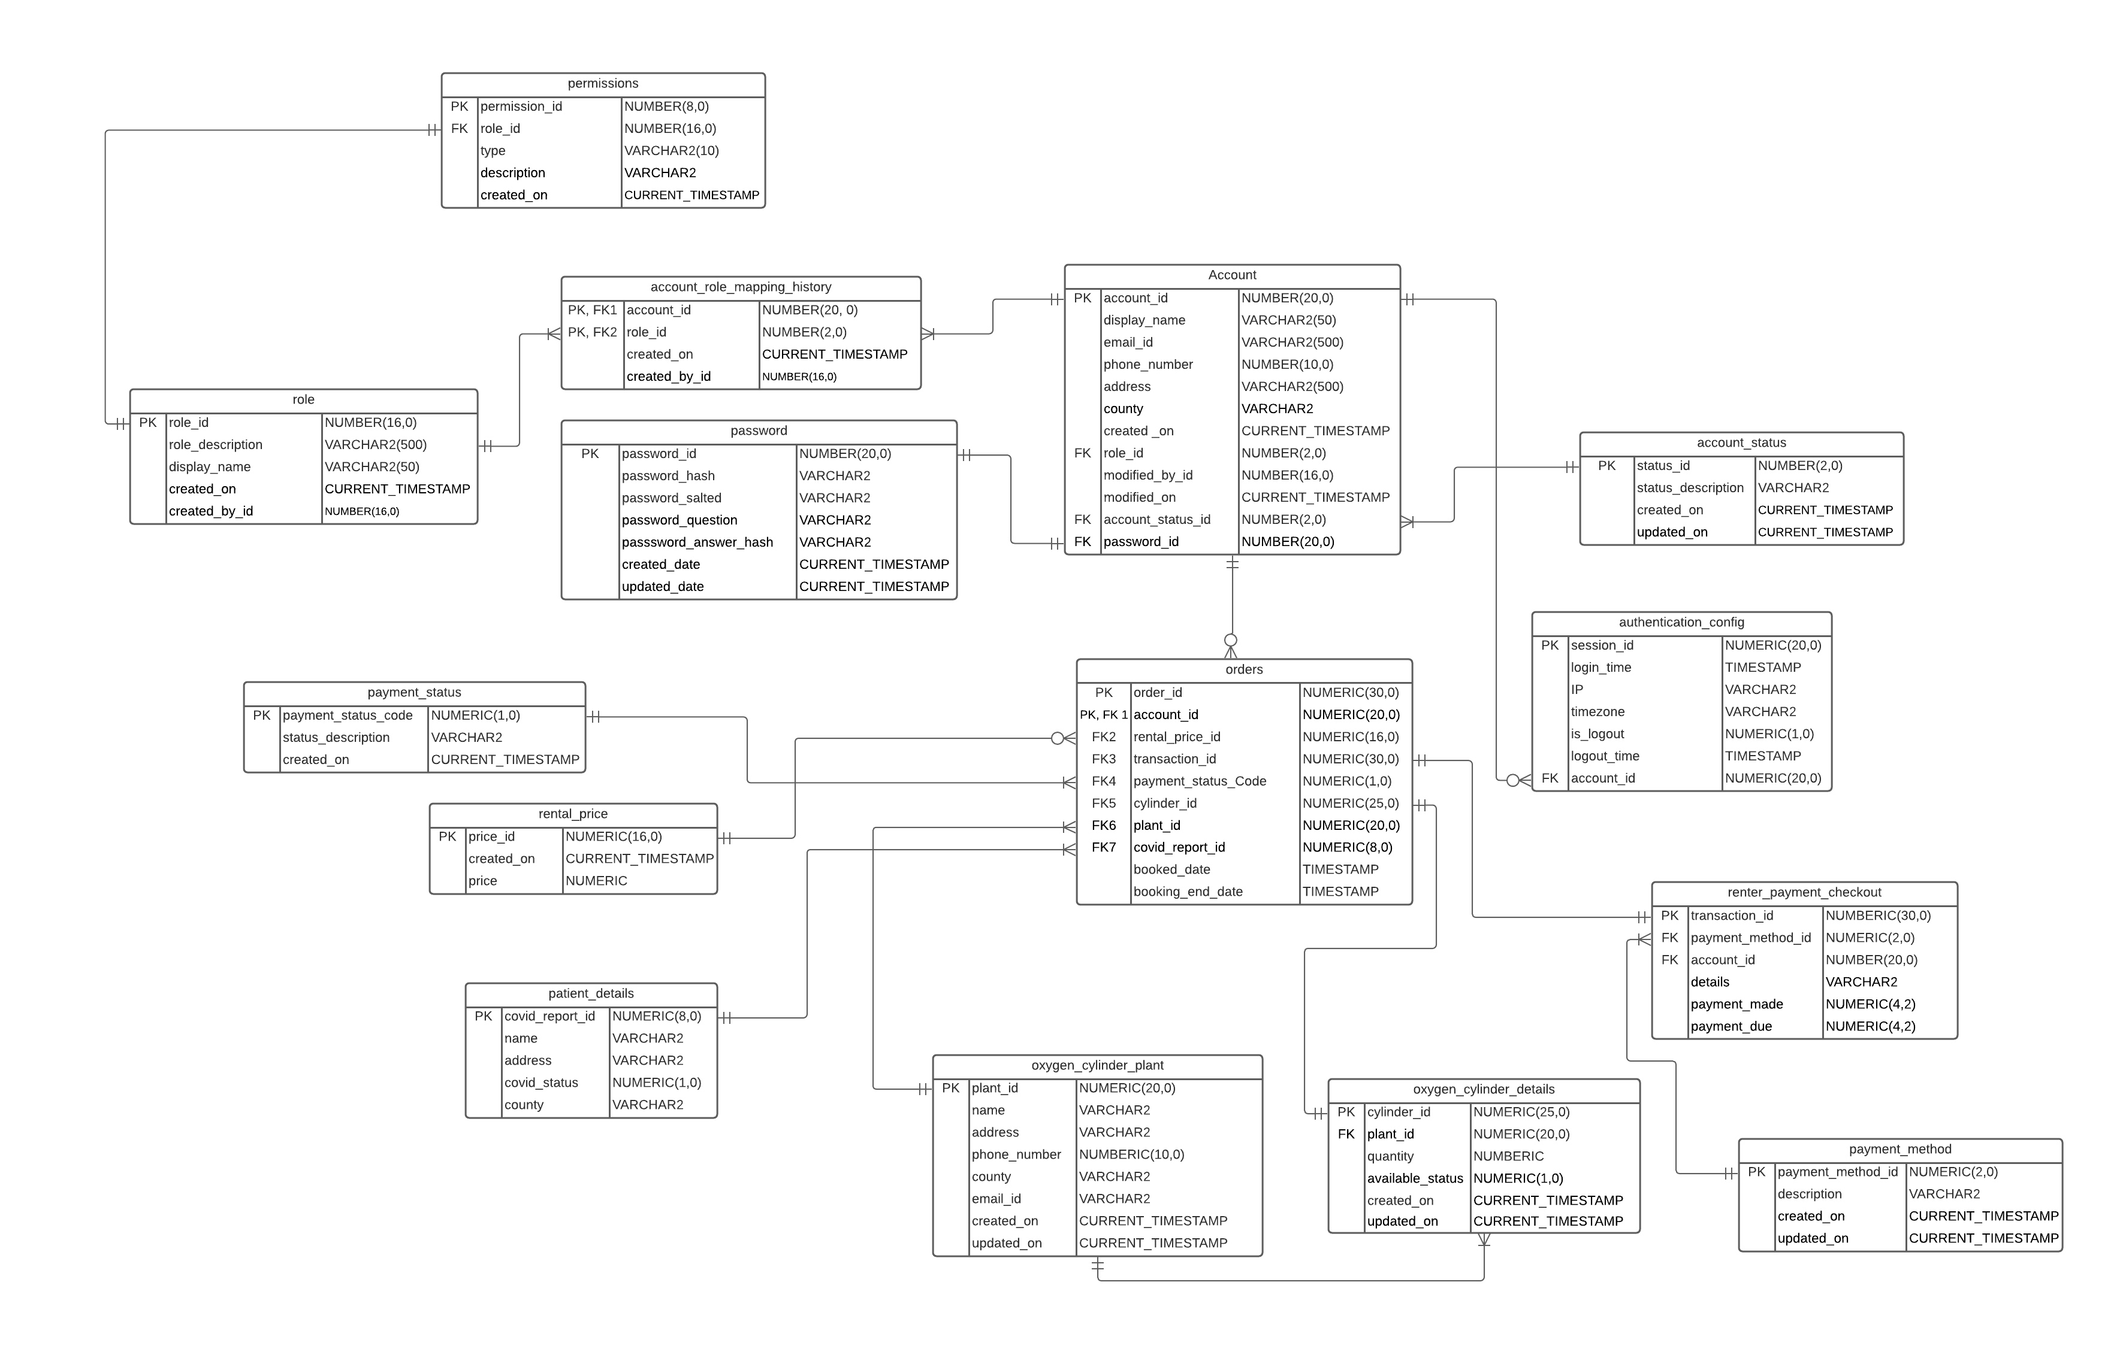
Entity-Relationship Diagram

Slide 4

GIT-Hub URL:
https://github.com/nithin-bharadwaj-369-NEU/oxygen_management_system

Slide 5
Modules:
S.NO. | TOPIC | DESCRIPTION
1. | DDL (Create/ Drop) | Created tables using Stored Procedures.
2. | DML (Insert) | Stored Procedures - Package Insert Functions (email, pwd encrypt, pwd salted) Procedures (Insert with validations) Exception Handling
3. | Indexes | To fetch values quicker.
4. | Triggers | Implementing manipulations of rows on Cylinder details table.
5. | Views & Reports | Created Views and respective user-defined reports in the form of charts.
6. | Test Cases | To justify the created validations.

Slide 6
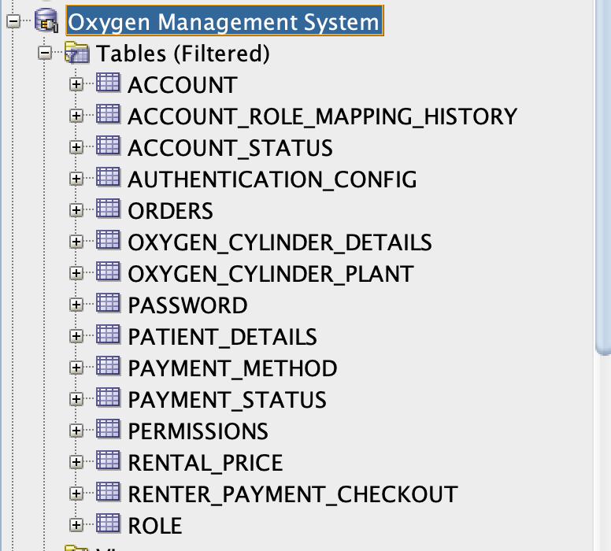

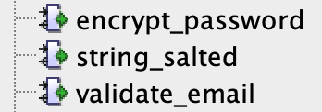
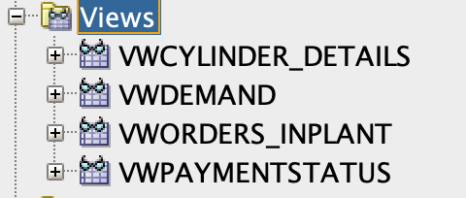
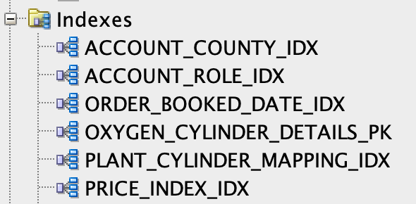
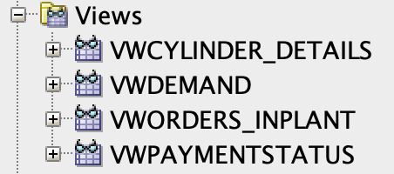
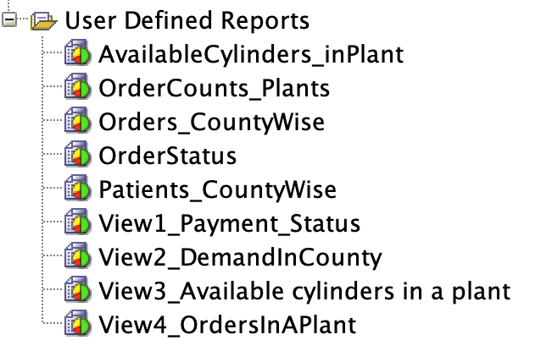
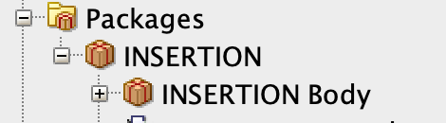
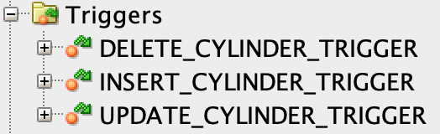
Data Objects:
Account User Roles:
Admin
Customer
Oxygen Supplier

Slide 7
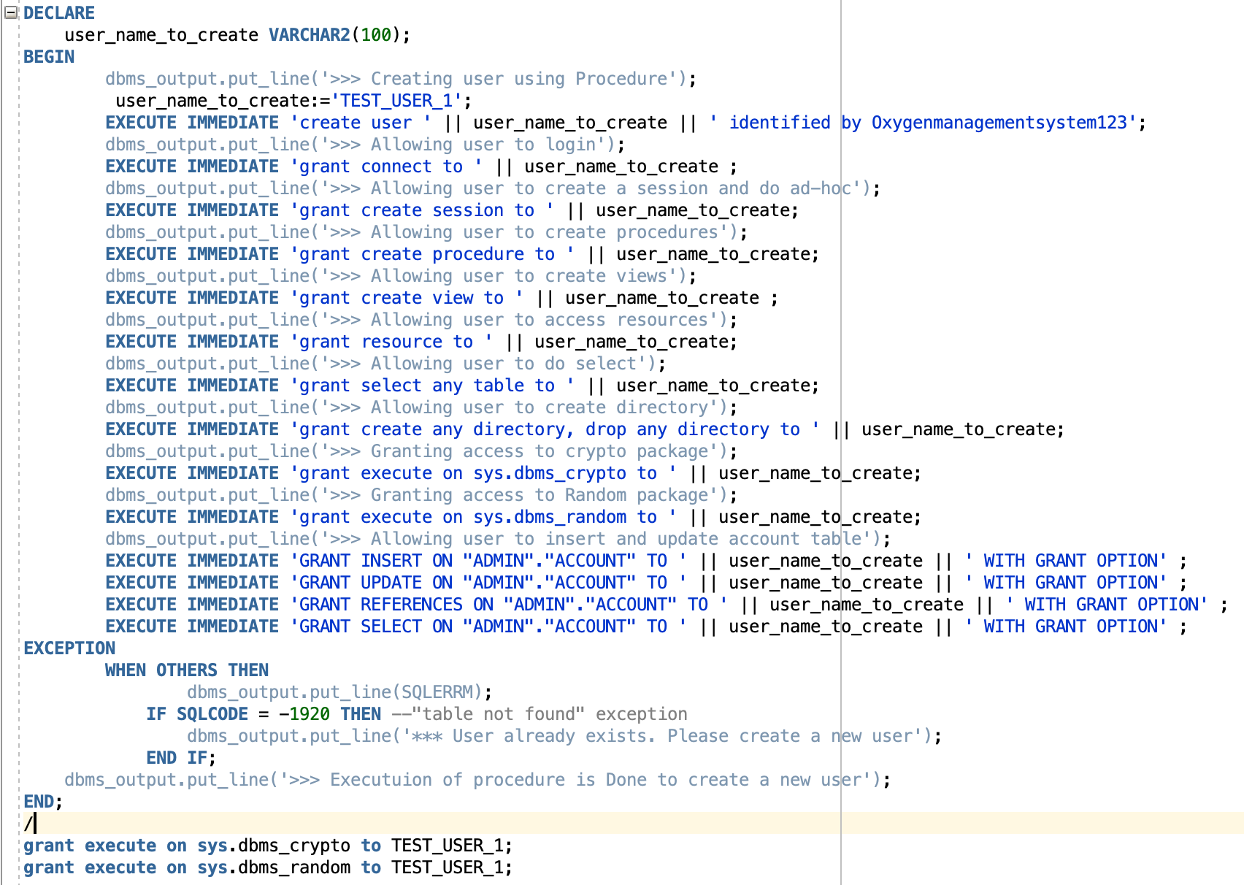
Grants:
Grants are created to preserve security.
Only the user who is granted access can have authority over the database.

Slide 8
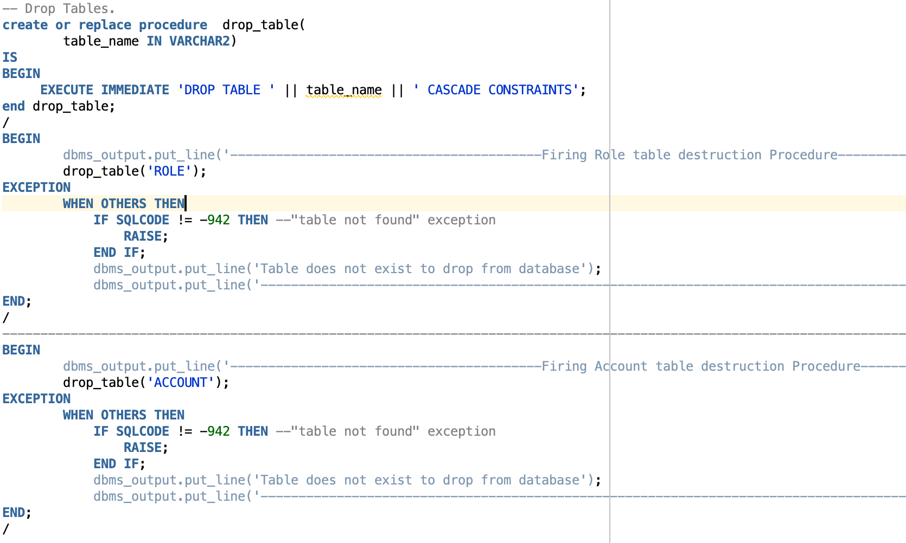
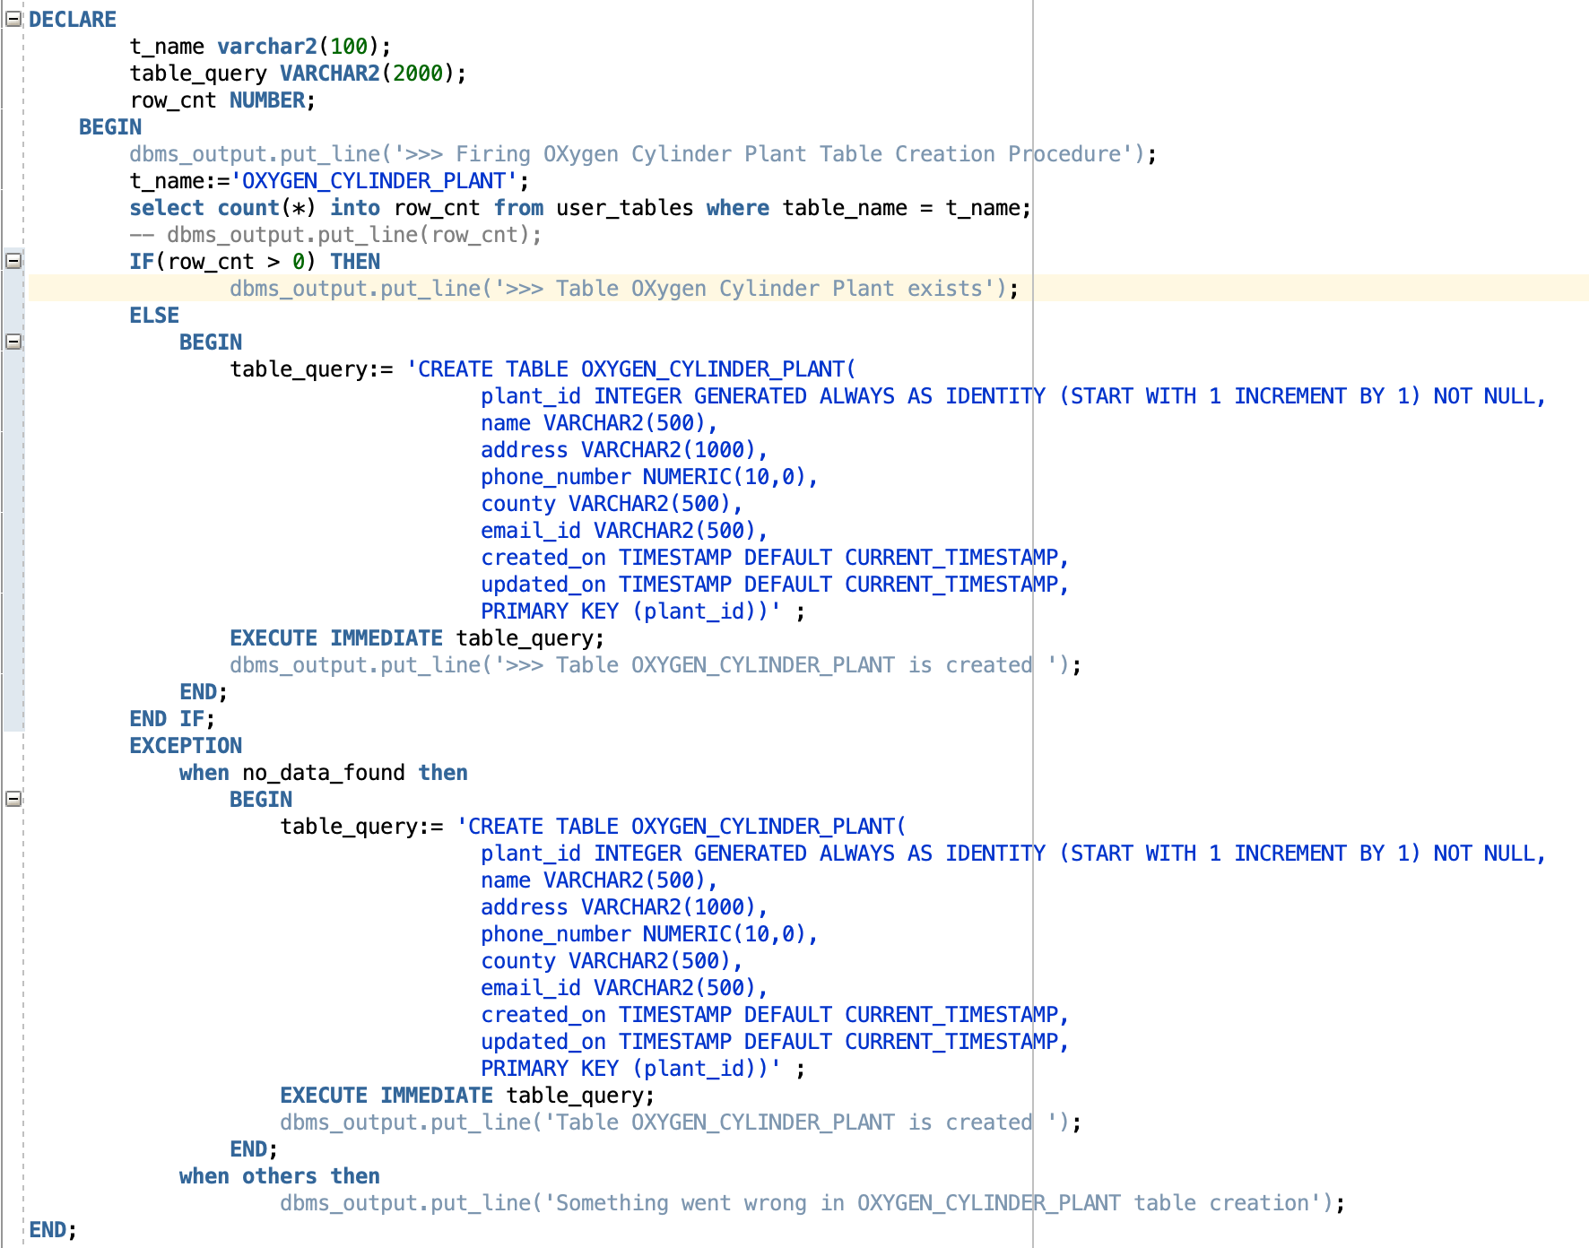
DDL – Drop & Table Creation
Procedure to Drop tables.
Passing table name as input Execute_immediate will run the drop statement
Declaring table name to be be created and table query to create it]t.
In Exception, we are Handling the case when table doesn’t exist.

Slide 9
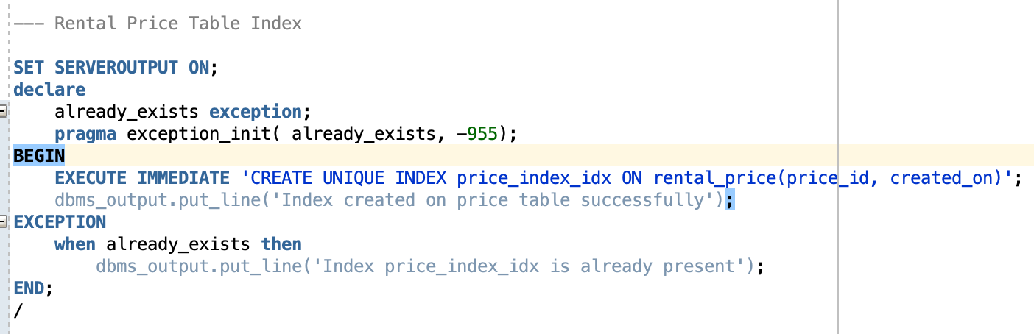
Indexes:
Rental Price Table Index
Oxygen Cylinder Table Index
Account Table Index Account_id and County Index
Account_id and Role_id Index
Order_id and booked_date
Exception handling
Creating an Index

Slide 10
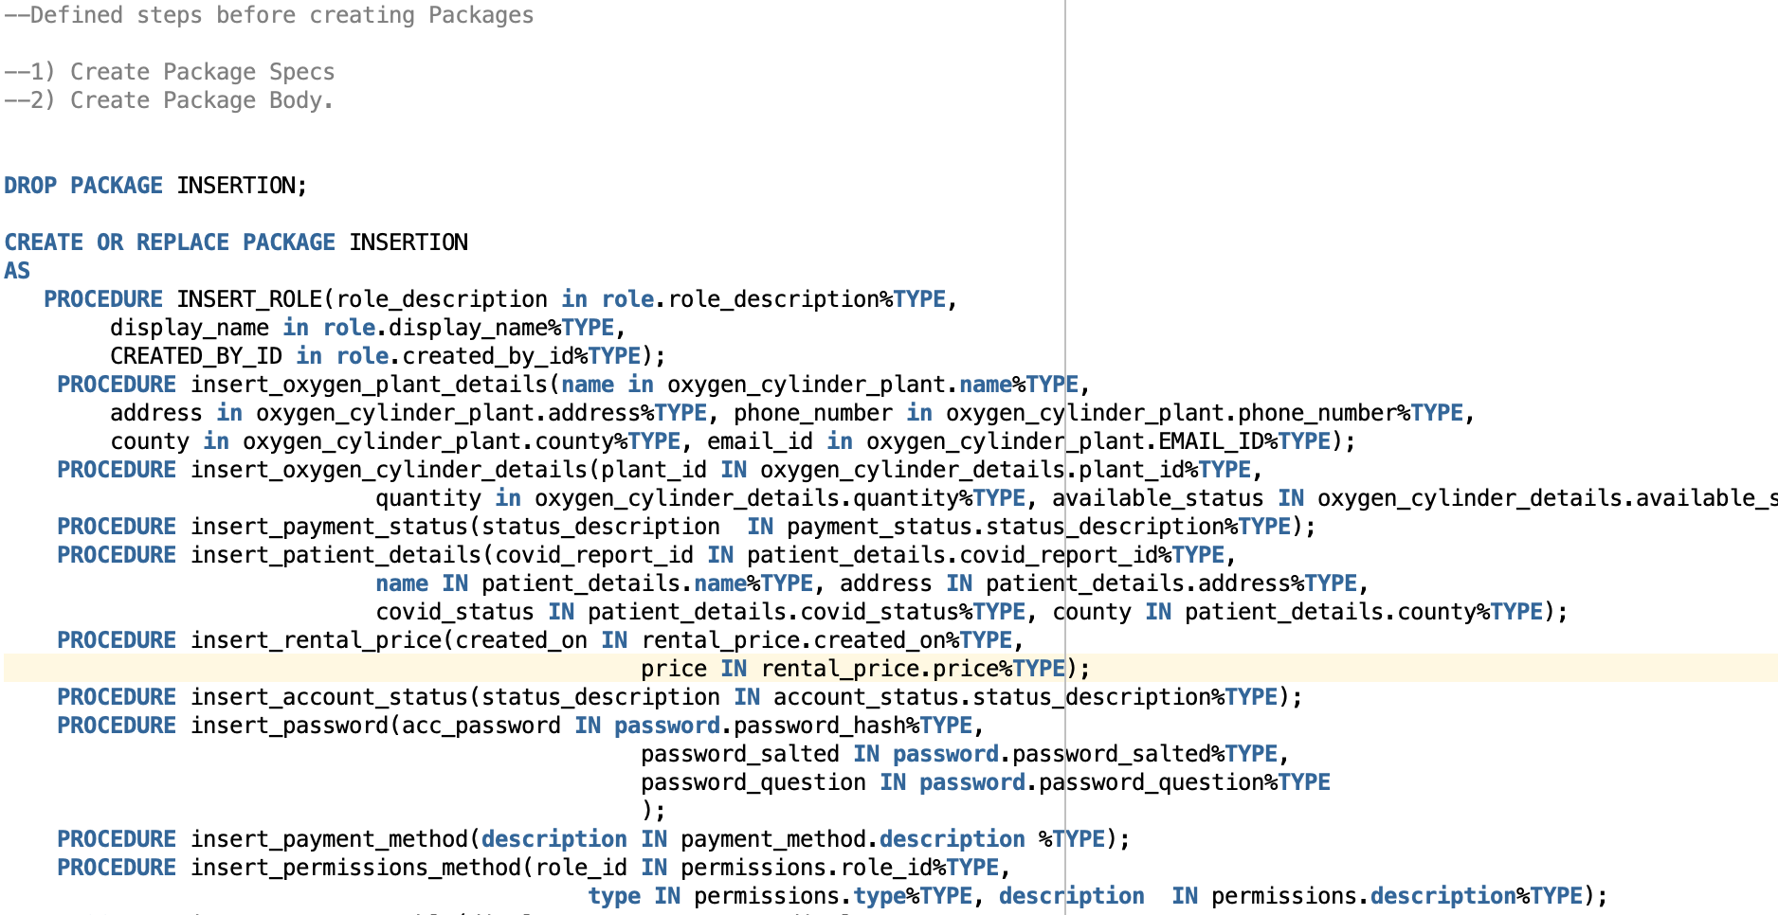
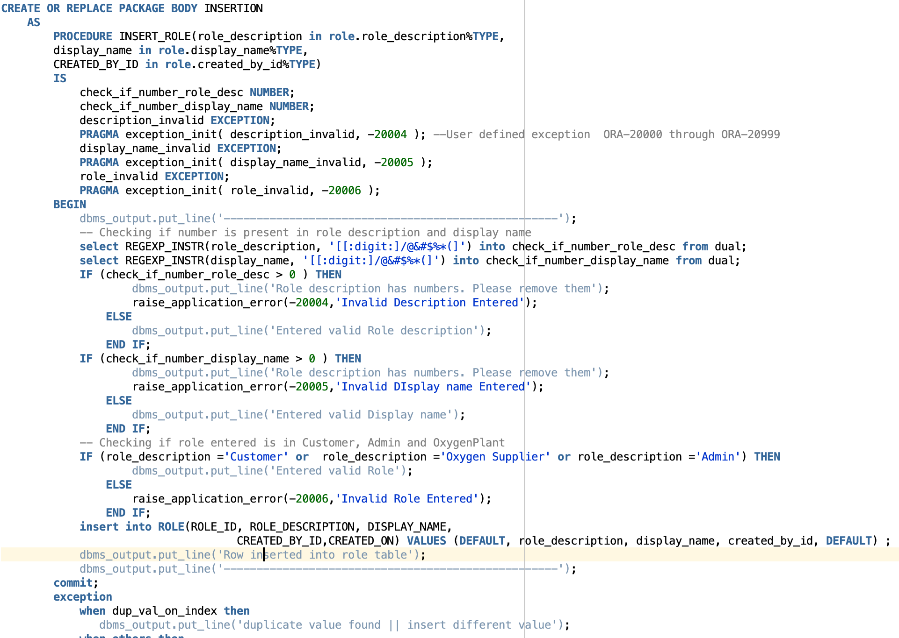
DML – Insert Data
Drop Insert Package
Creating “Insertion” Package
Package Body Implementation
Procedure “Insert Role” implementation
Exceptions
Validations

Slide 11
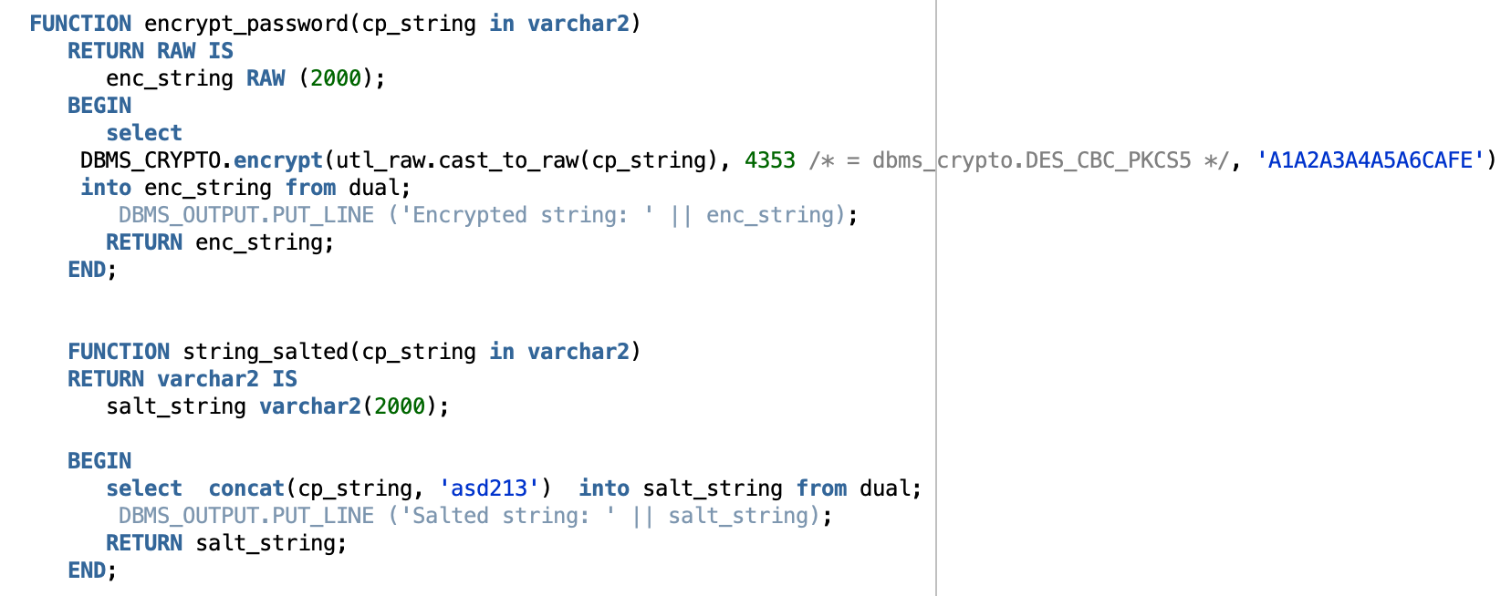
Functions:
encrypt_password
string_salted
validate_email
Encryption Function
Encryption Algorithm Used
Secret Key
Salting Function used to append a string to the password for encryption.

Slide 12
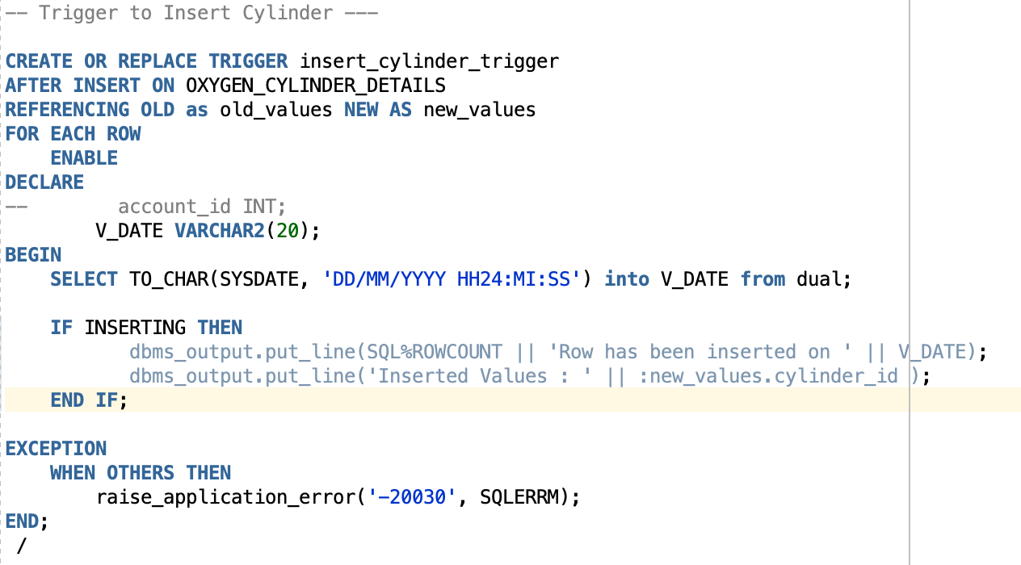
Triggers:
Trigger to Insert/ Update/ Delete Cylinder.
Creating Trigger
Handling exception

Slide 13
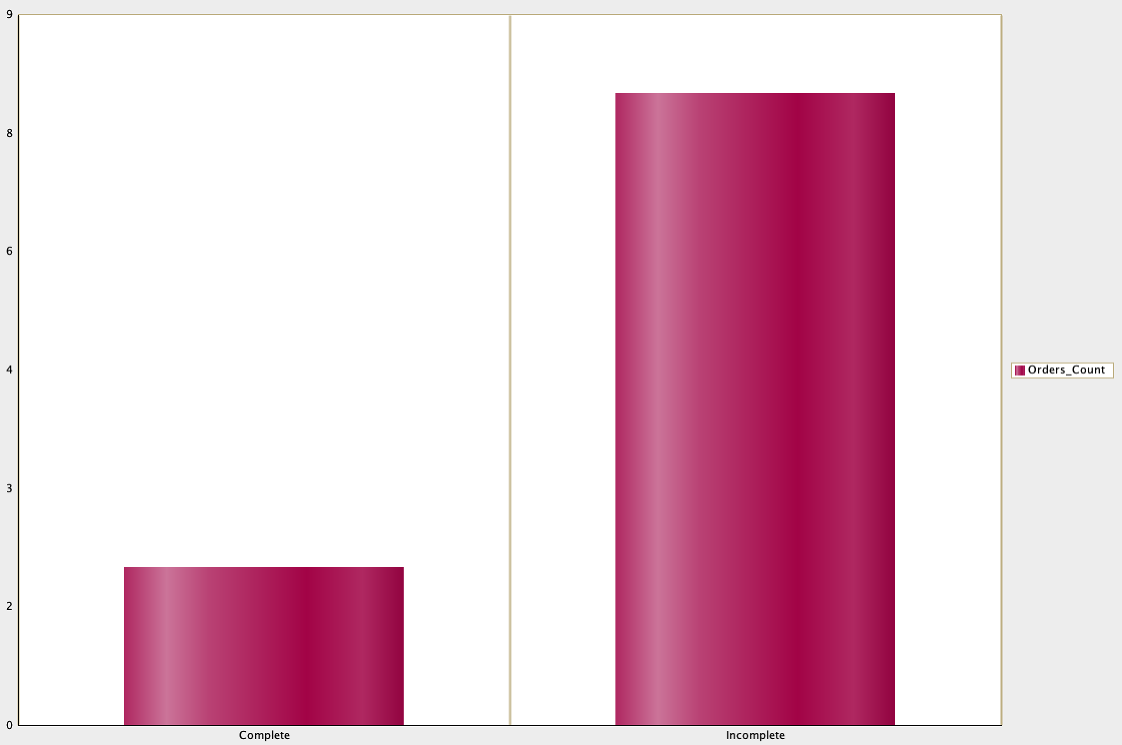
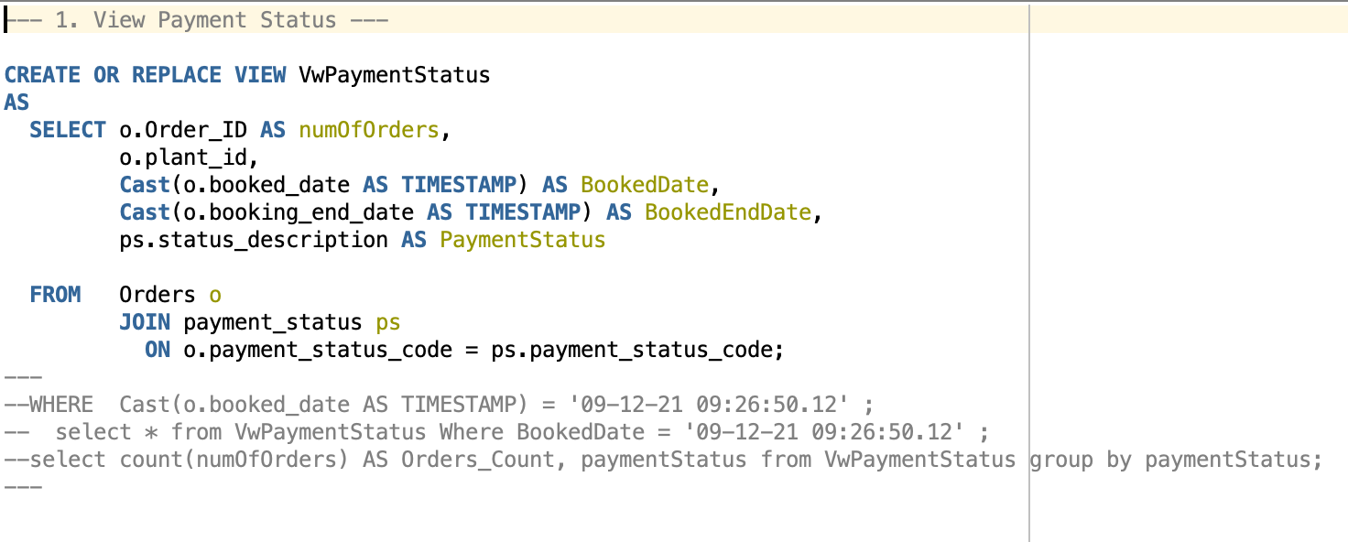
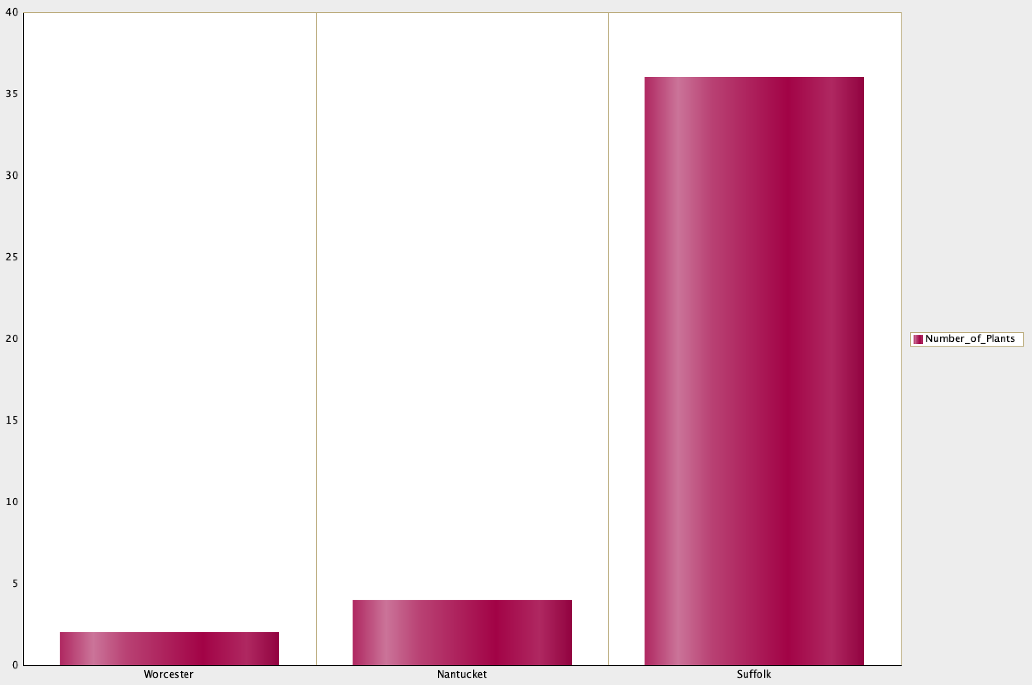
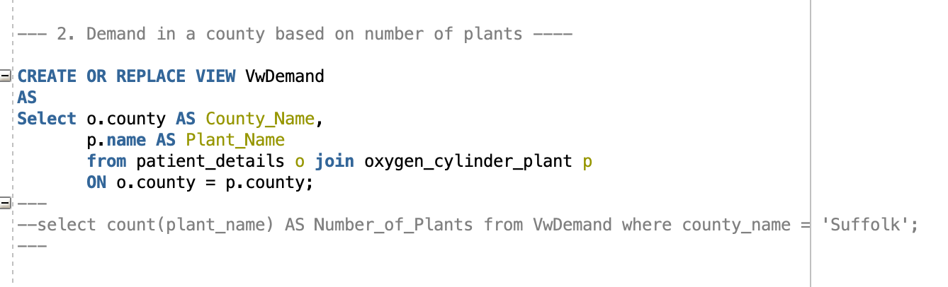
Views & Reports:

Slide 14
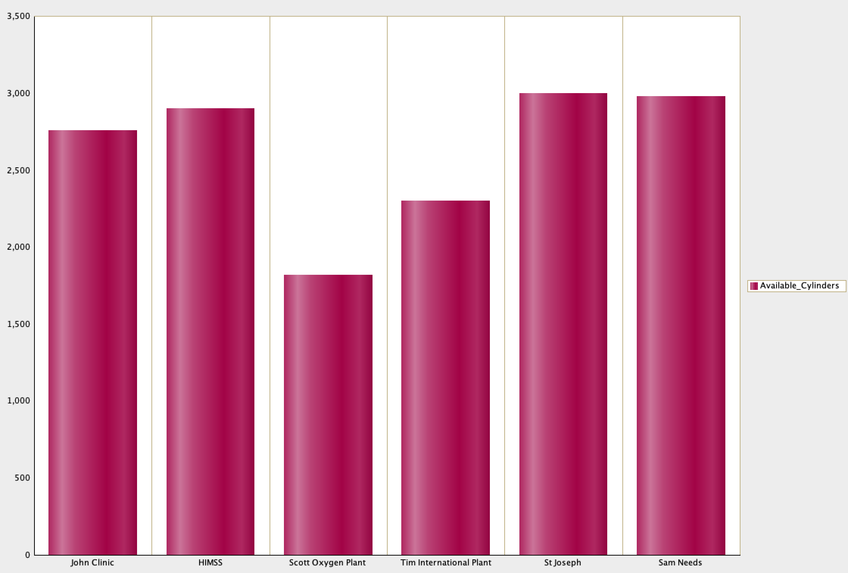
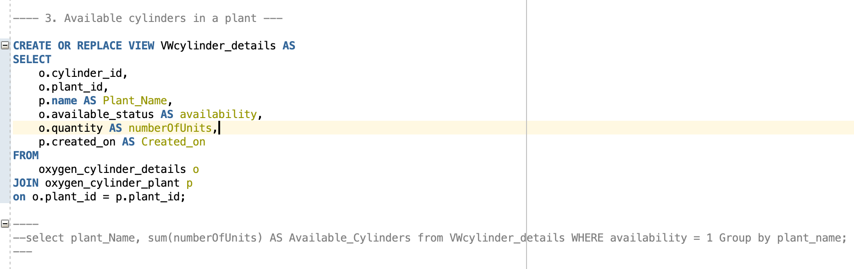
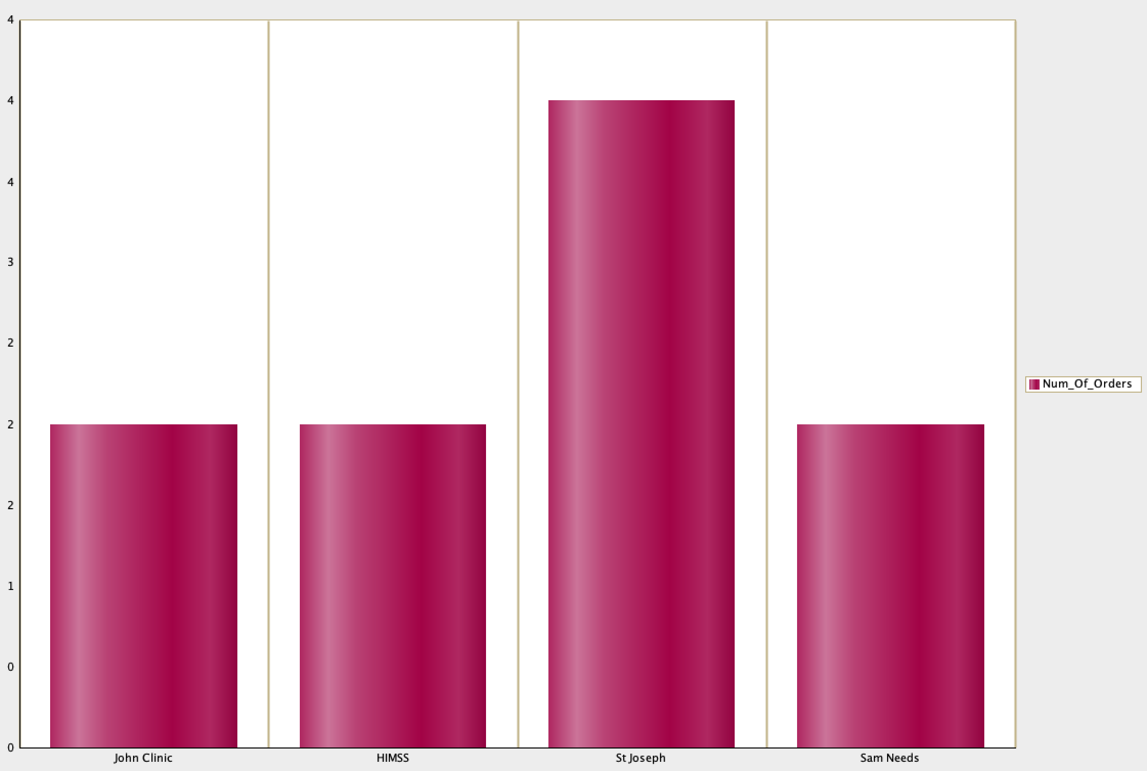
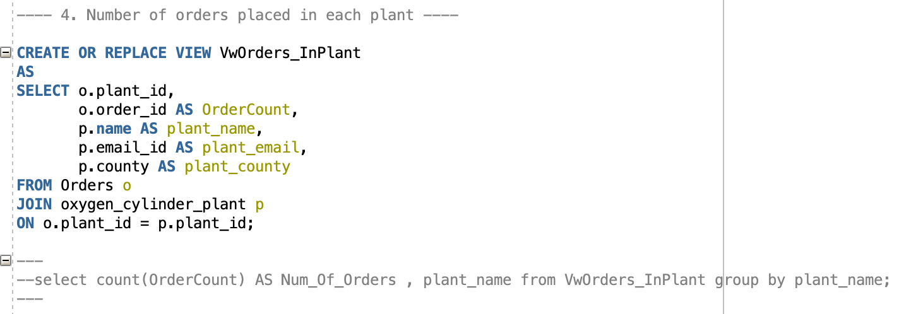
Views & Reports

Slide 15
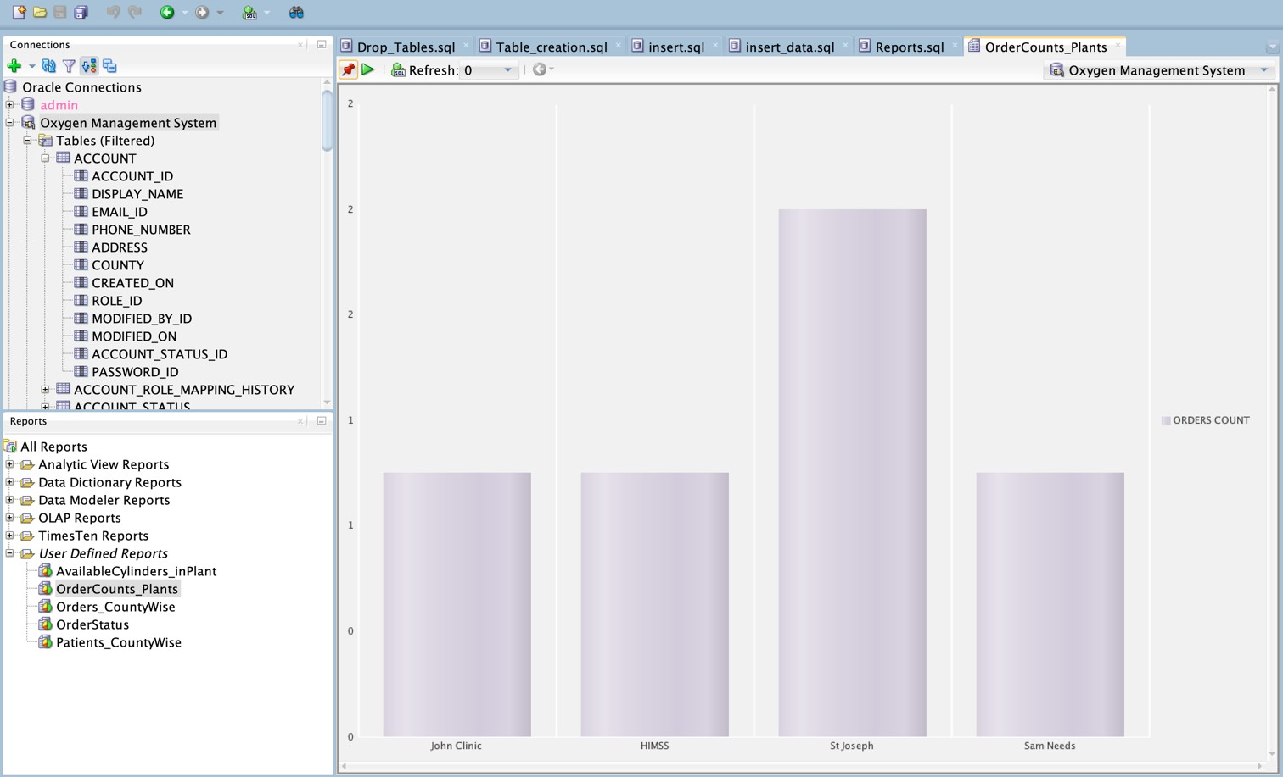
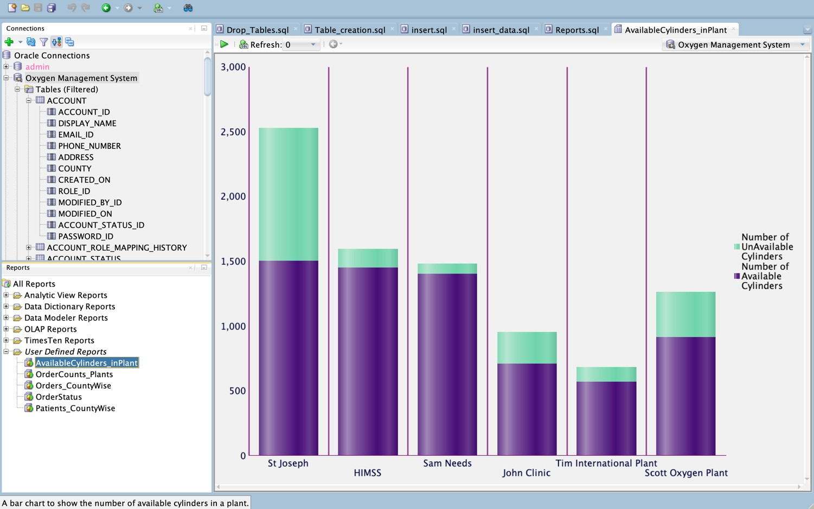
VISUALIZATION REPORTS USING QUERIES:
1. Count of orders raised at a Plant.
2. Number of Available and Unavailable Cylinders at a Plant.

Slide 16
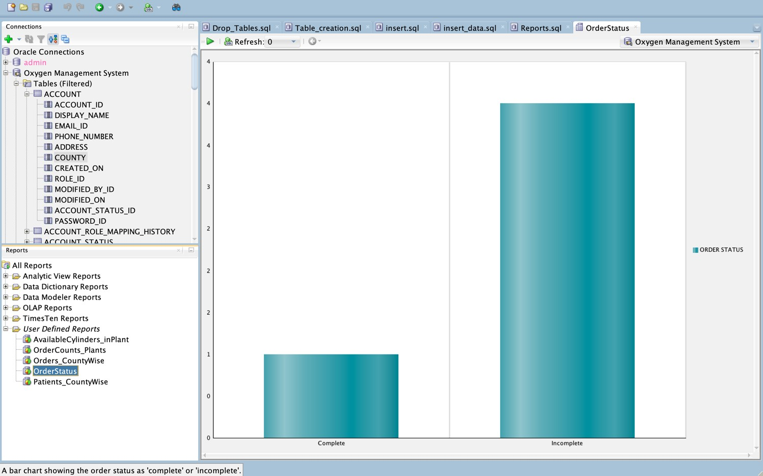
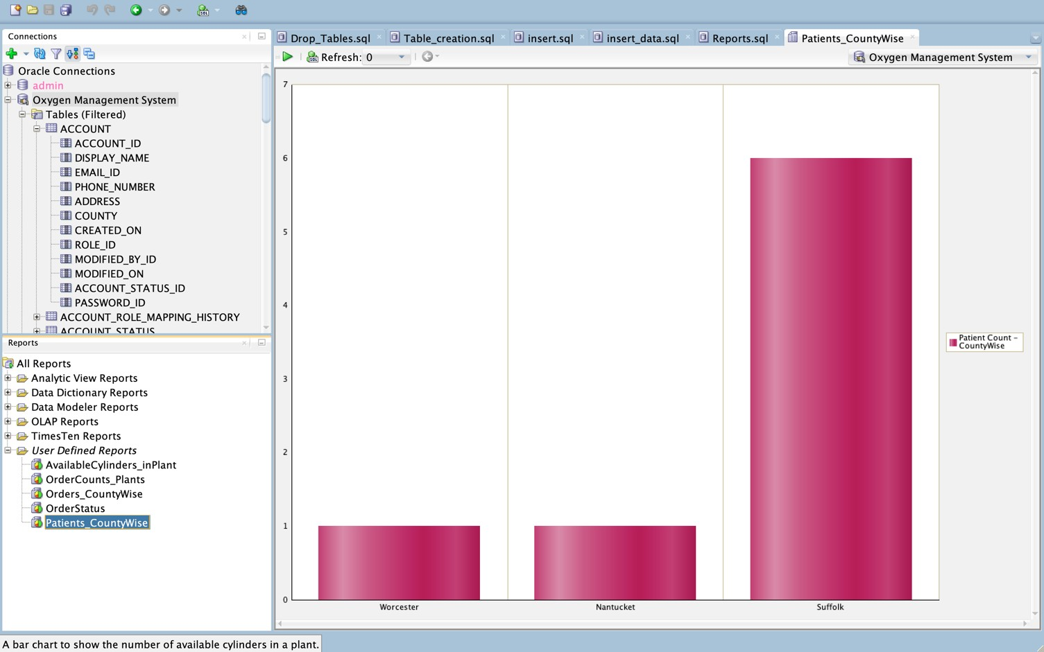
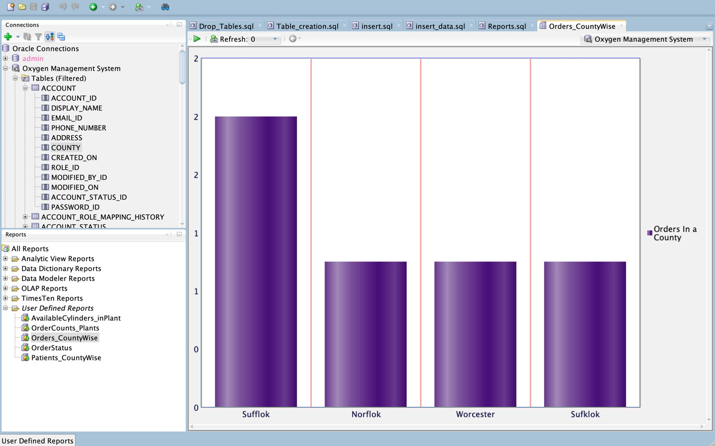
3. Number of patients in a county
4. Order Status : Complete (or) Incomplete
5. Order according to the county.

Slide 17
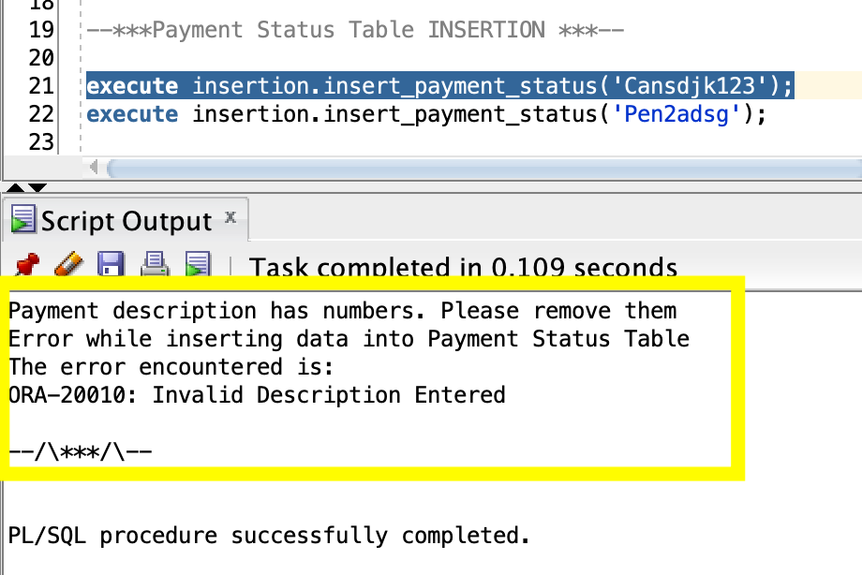
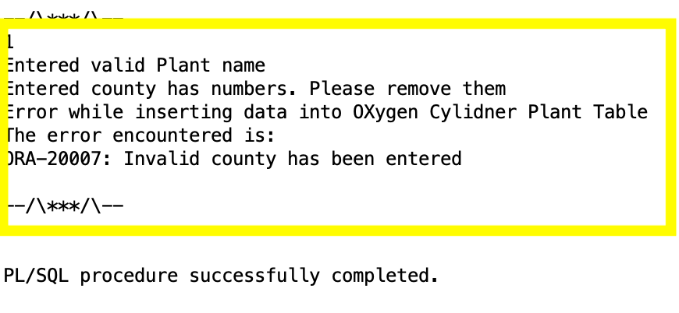
Test-Cases (2 examples):
execute insertion.insert_payment_status('Cansdjk123');
execute insertion.insert_oxygen_plant_details('HIMS123123S', '290, St Alphansous Street', 6176859691, 'MiddleSex123', 'josephplant@gmail.com');

Slide 18
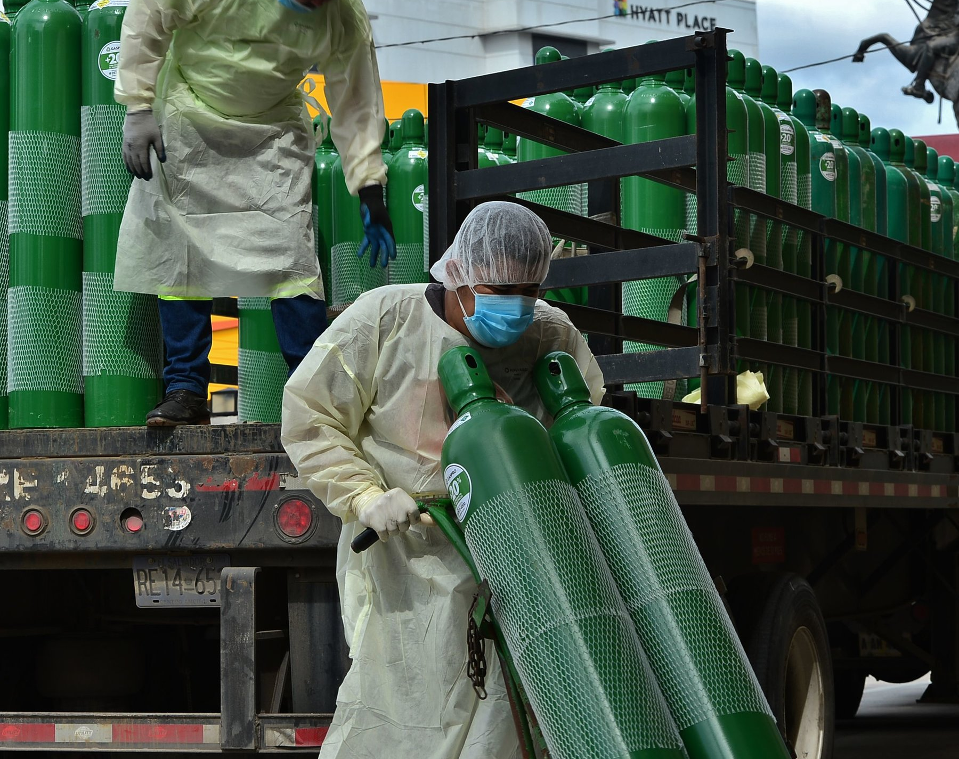
DEMO

